Slide 1



National Coordination Centre
Pharmacovigilance Programme of India
ADR REPORTING- MEDICAL CONTENT NEEDED FOR ANALYSIS

Slide 2
National Coordination Centre
Pharmacovigilance Programme of India
GROUND PLAN
Minimum requirement for reporting
Clinical diagnosis
PV Reviewer’s thrust query
Reality
Conclusion

Slide 3
National Coordination Centre
Pharmacovigilance Programme of India
MINIMUM REQIURNMENT FOR REPORTING
A Patient (patient initials, age & gender)
A Reporter
An ADR
A Drug
-> Valid case

Slide 4
National Coordination Centre
Pharmacovigilance Programme of India
CLINICAL DIAGNOSIS
Information about the patient
- Demographics
- Family/ personal medical history
Information about the current problem
- Description
- Measures taken by patient

Slide 5

National Coordination Centre
Pharmacovigilance Programme of India
Physical examination
Additional investigation
- Lab test
- X ray etc

Slide 6
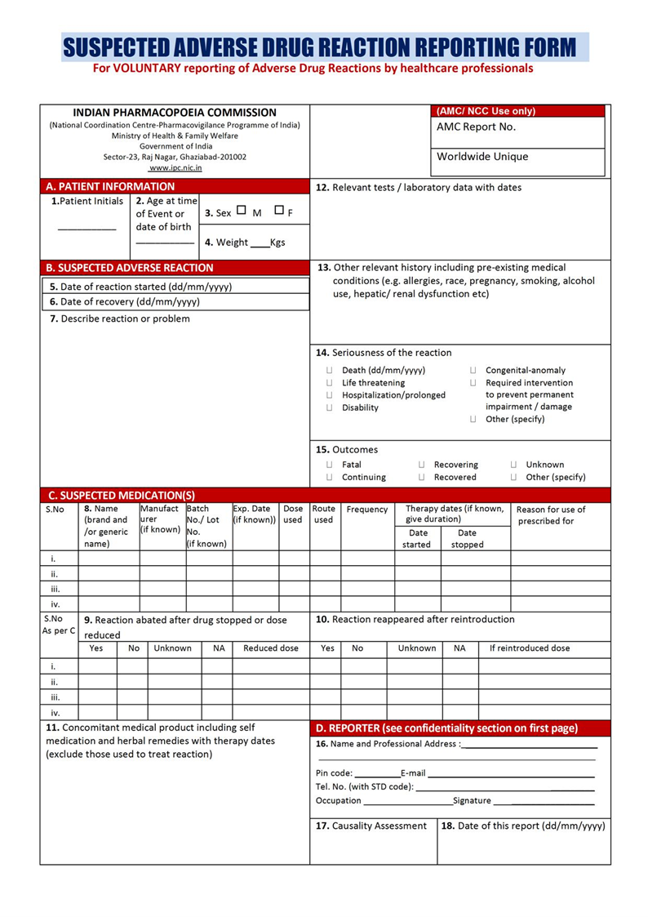
ADR FORM

Slide 7
National Coordination Centre
Pharmacovigilance Programme of India
The reporting form should provide the same
information as a clinical would seek when interviewing/ examining/ treating a patient.
Mandatory fields to be filled in suspected ADR Form
Patient initial
Date of reaction started
Describe reaction or problem
Suspected medication
Concomitant drug
Outcome of reaction
Reporter name
Date of report

Slide 8
National Coordination Centre
Pharmacovigilance Programme of India
PV Reviewer’s thrust query
Patient
-Age
-Gender
-Ethnicity
-Height/weight
-Family/personal history
-Recreational habits

Slide 9
National Coordination Centre
Pharmacovigilance Programme of India
ADR
Exact chronology (reaction term)
Severity (how many times the patient has come across the targeted reaction in the life span )
Seriousness
Development (Congenital-anomaly, disabling, death)
Measures taken
Outcome

Slide 10
National Coordination Centre
Pharmacovigilance Programme of India
DRUGS
Active ingredient
Product
Batch number
Dose regimen
Route of administration
Duration
De/Rechallenge

Slide 11
National Coordination Centre
Pharmacovigilance Programme of India
FINDINGS
Physical examination
Lab test appropriate
Other investigations (X ray, CT-scan, post-martum analysis in case of death )

Slide 12
National Coordination Centre
Pharmacovigilance Programme of India
REALITY
Reports often lack the essential information
Following up incomplete reports is onerous and often yields poor result
The first contact with primary reporter is crucial

Slide 13
National Coordination Centre
Pharmacovigilance Programme of India
CONLUSION
Reporting tools must be burden free and user friendly
However they should provide the information needed for a sound assessment to allow risk minimising action to be taken
It should be prerogative for an automated dat exchange.

Slide 14
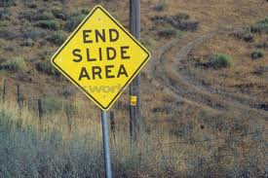
National Coordination Centre
Pharmacovigilance Programme of India

